Slide 1

Lego developer case 2024
Developer presentation
Aleks Dubinskiy

Slide 2
Data provided
AssetMetadata.json - contains information about individual assets
BriefingMetadata.json - information about a “briefing” of an asset.
assumption: e.g. the internal history of an asset within the company?.
missing: link to the assetId. Can be recovered by matching name and description
redundant: some of the information already specified in the Asset (name and description), once the link to asset can be established, these properties can be dropped.
Side note: the properties specified can be simply recovered via the Asset’s history within the CMS / source control?
ContentDistributionMetadata.json - specifies distribution channels / methods / dates for a set of assets.
assumption: Specifies where a customer might find the specified assets once the order is complete
OrderListMetadata.json - collection of assets requested by customer
Specifies a list of asset requested by a customer
Can be linked to BriefingMetadata via the assetIds, so we have information for a specific asset’s requester and creator(s) / editor(s).

Slide 3
Solution Architecture
The solution will consist of
The data repository
An abstraction on the storage solution (the original .json files, a DB, or a CMS)
The model
Representation of the underlying data in the code.
Backend services
implement the business logic (queries / async calls / massage the data etc.)
WebAPI / Controllers
the endpoints for external services to consume.
Abstracts the implementation the of data storage solution, and provides only the parts relevant to the consumer.
Assuming: Rest API

Slide 4
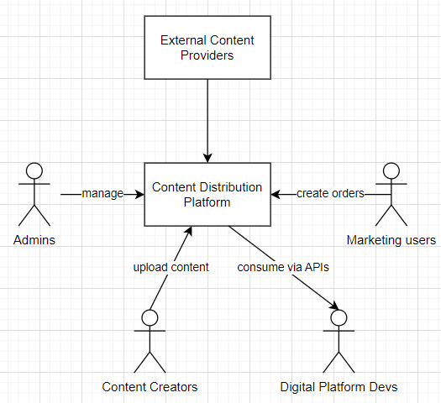
Context (C1)
Various actors interacting with the Content Distribution Platform:
Admins
Content creators
Platform devs
Marketing users

Slide 5
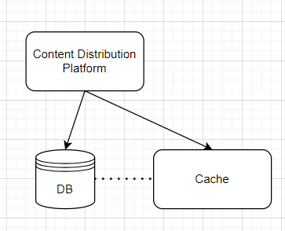
Containers (C2)
Since the main bottleneck is the assets themselves, and not the application, the database layer takes care of the scale and the performance. Thus the architecture on the container side is straightforward

Slide 6
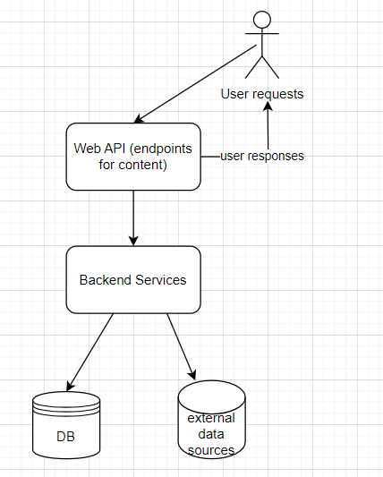
Components (C3)
Internal structure of the application
API layer - serves as an interface between the users and the platform
Backend services - abstracts the storage implementation details, implements business logic
DB and data sources - the underlying data structures

Slide 7
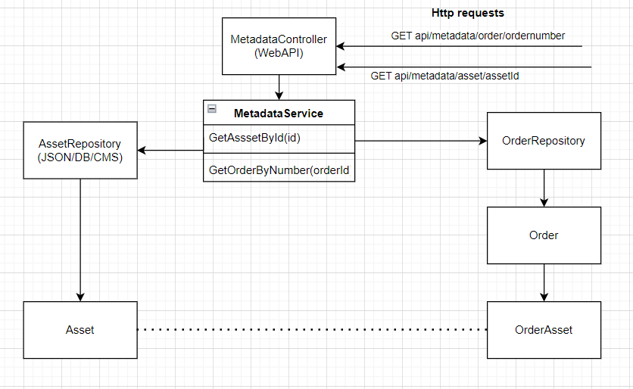
Code (C4)
Internal structure of the application
Metadata - the original JSON files on disk
Controllers - routing logic
Services - business logic
Model - C# classes representing the datastructures based on JSON files
docs/ documentation

Slide 8
Future actions
This is a mockup of a larger system
Future actions
Discuss with the end users what kind of requests will be anticipated
Design a more full-fledged API
Decide on a storage solution
DB vs. CMS vs. other options
Decide on a container solution
monolithic vs. microservices
Resolve any existing data relationships so that the system is easier to maintain in the future
Remove duplication
Add references

